Slide 1

从Transformer
到ERNIE

Slide 2
01
RNN
02
Transformer
03
BERT
目 录
04
ERNIE

Slide 3
RNN

Slide 4



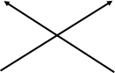
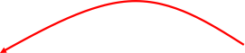

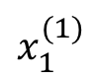
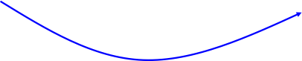
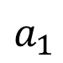
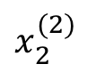
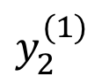
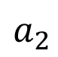
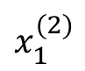
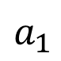
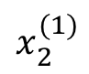
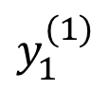
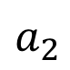
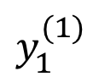
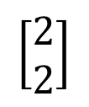
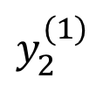
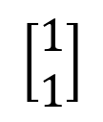
4
4
12
12
$$y_{1}^{(1)}$$
$$y_{2}^{(1)}$$
$$y_{1}^{(1)}$$
$$y_{2}^{(1)}$$
4
4
12
12
0
0
2
2
$$a_{1}$$
$$a_{2}$$
2
2
$$a_{1}$$
$$a_{2}$$
6
6
$$x_{1}^{(1)}$$
$$x_{2}^{(1)}$$
$$x_{1}^{(2)}$$
$$x_{2}^{(2)}$$
1
1
2
2
$$\left[\begin{aligned}1 \\ 1\end{aligned}\right]$$
$$\left[\begin{aligned}2 \\ 2\end{aligned}\right]$$

Slide 5
RNN
LSTM

Slide 6
Sequence to Sequence模型

Slide 7
Attention机制

Slide 8
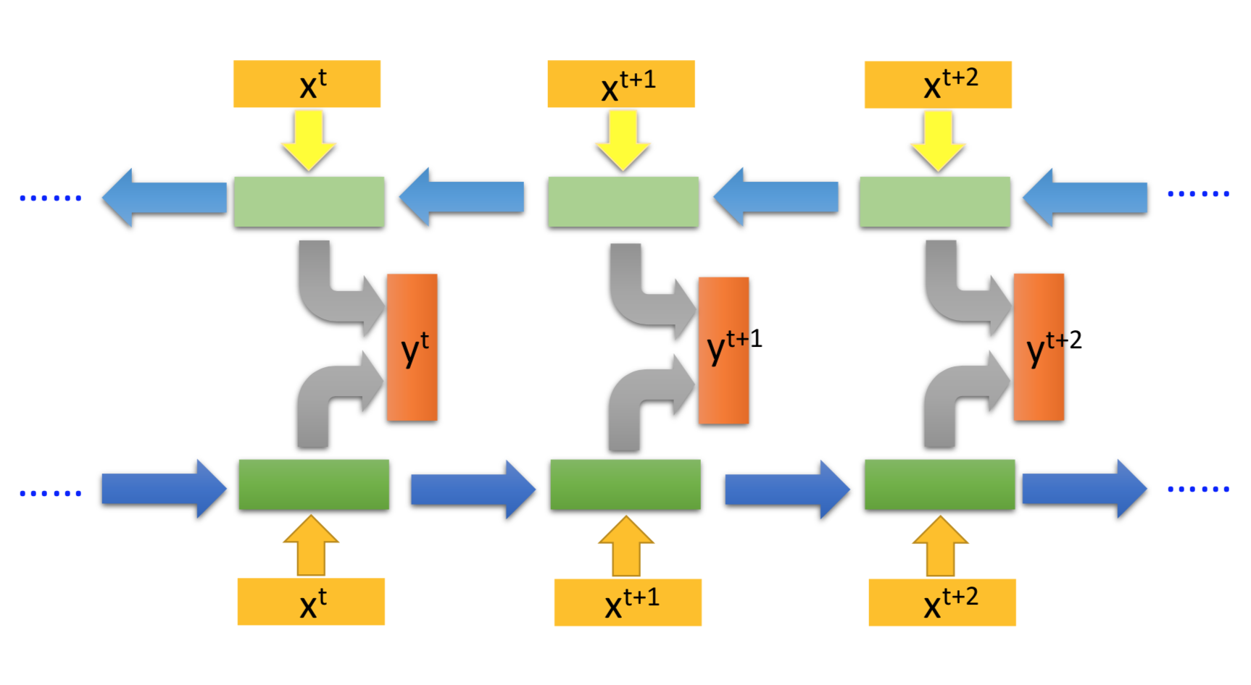
Bidirectional RNN

Slide 9
Transformer

Slide 10
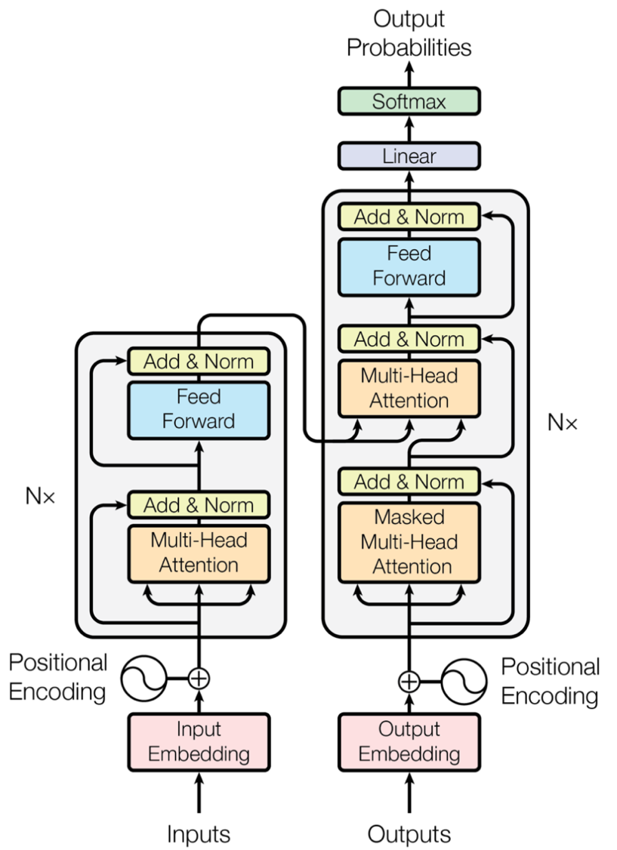

Slide 11
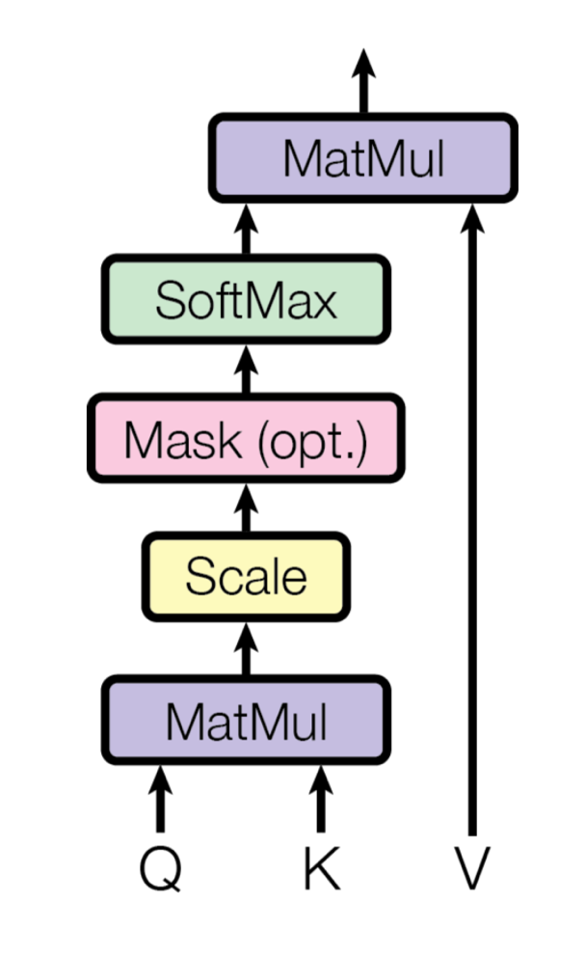
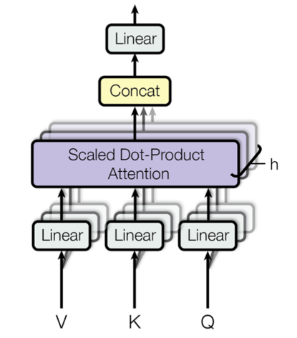
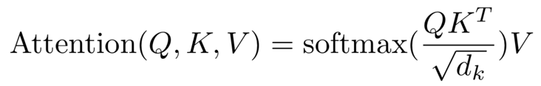
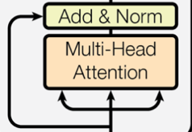
Attention Is All You Need

Slide 12
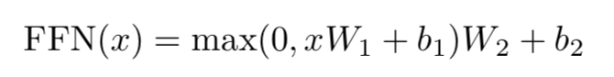
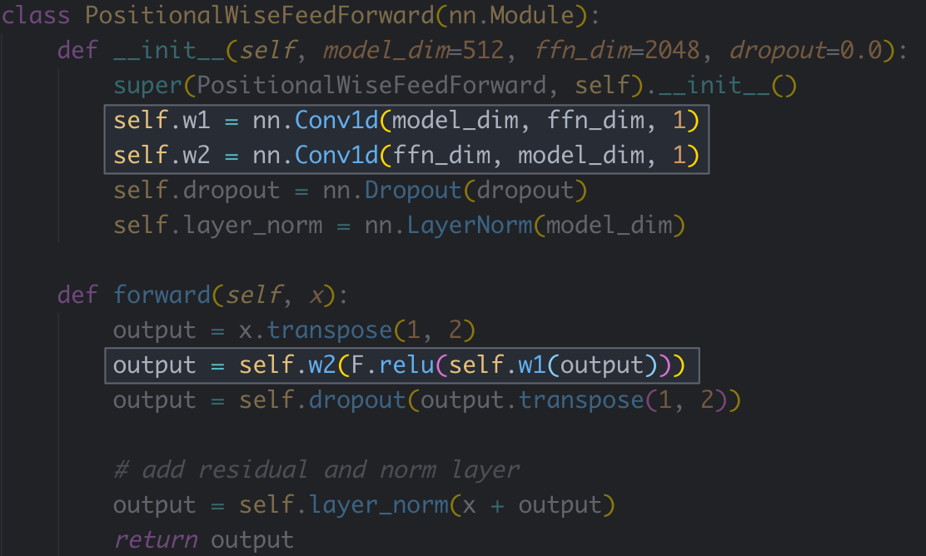
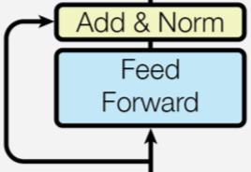
Attention Is All You Need

Slide 13
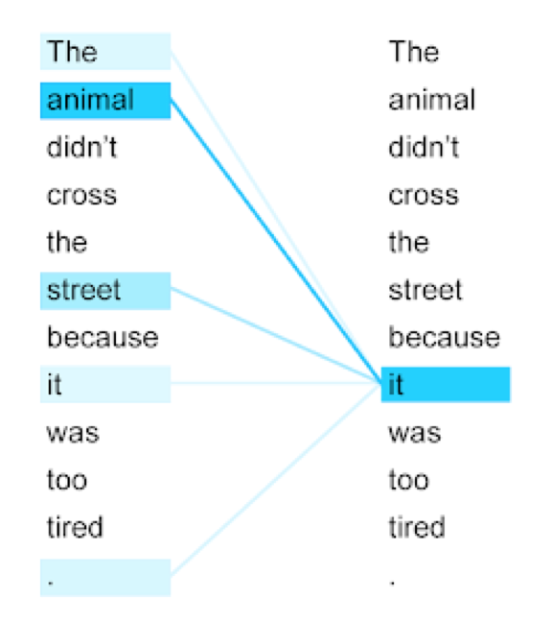
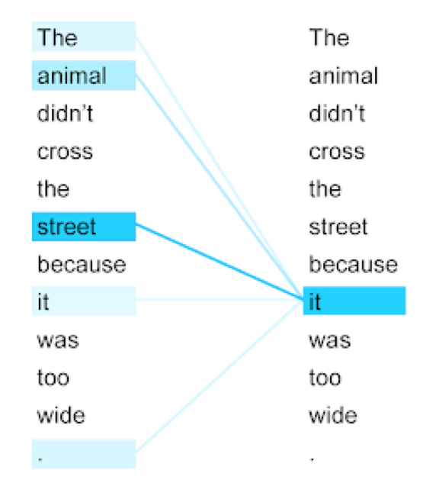
Attention Is All You Need

Slide 14
BERT

Slide 15
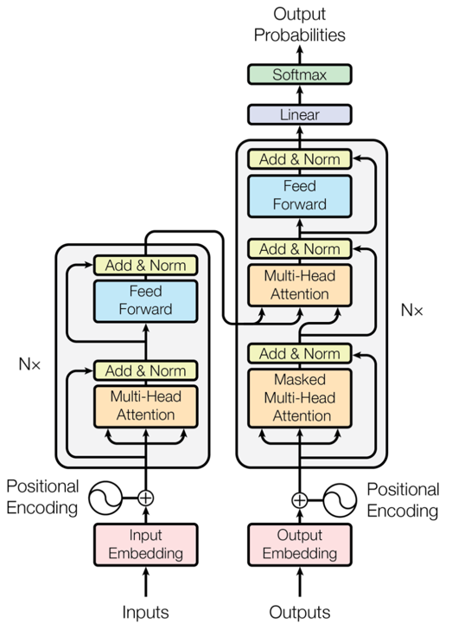
BERT
Encoder

Slide 16
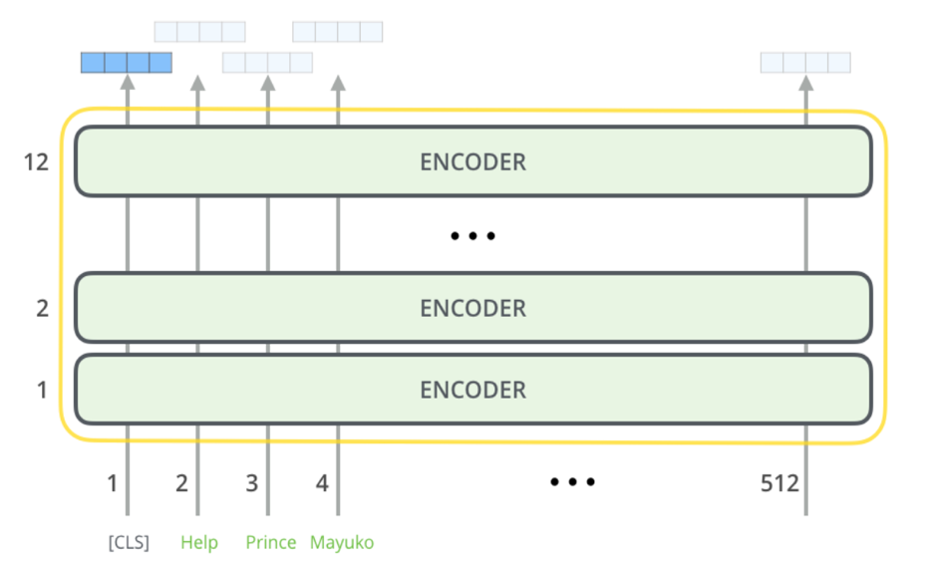
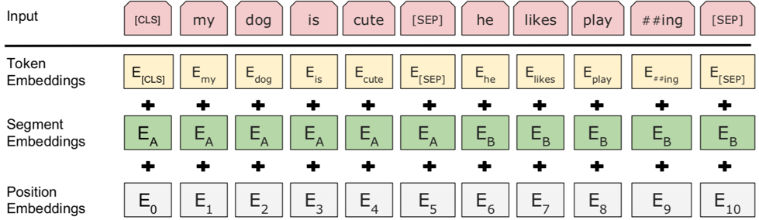
BERT

Slide 17
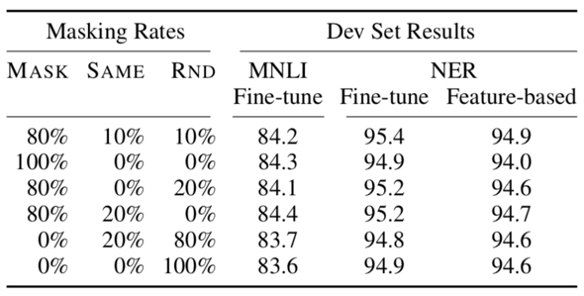
Task #1: Masked LM

Slide 18
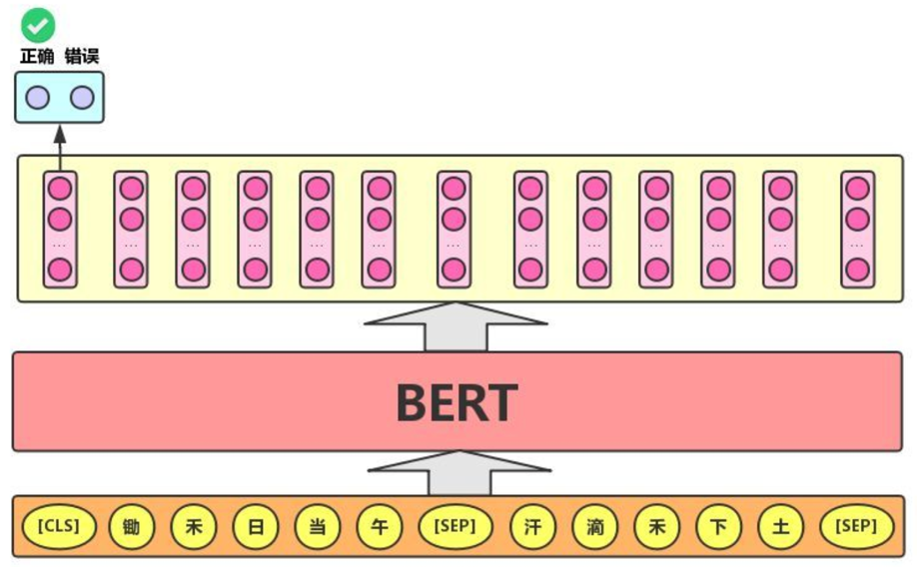
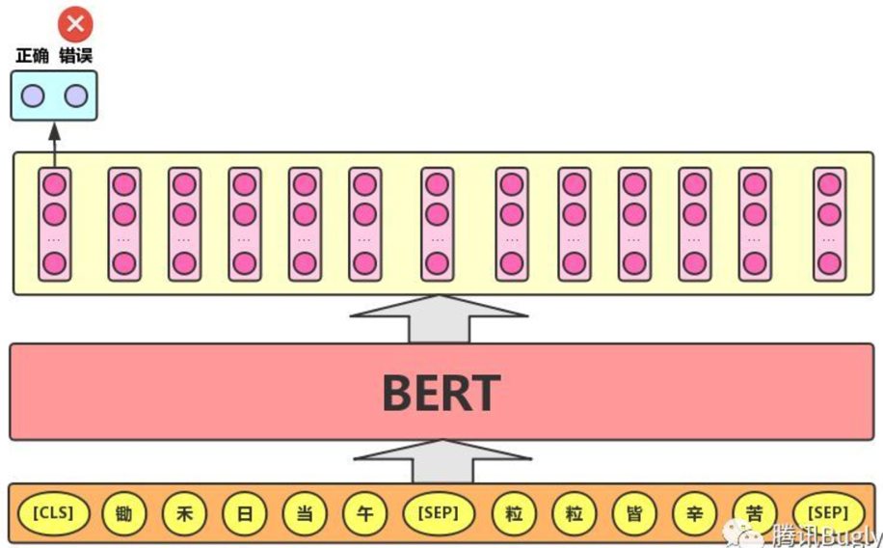
#2: Next Sentence Prediction (NSP)

Slide 19
ERNIE

Slide 20
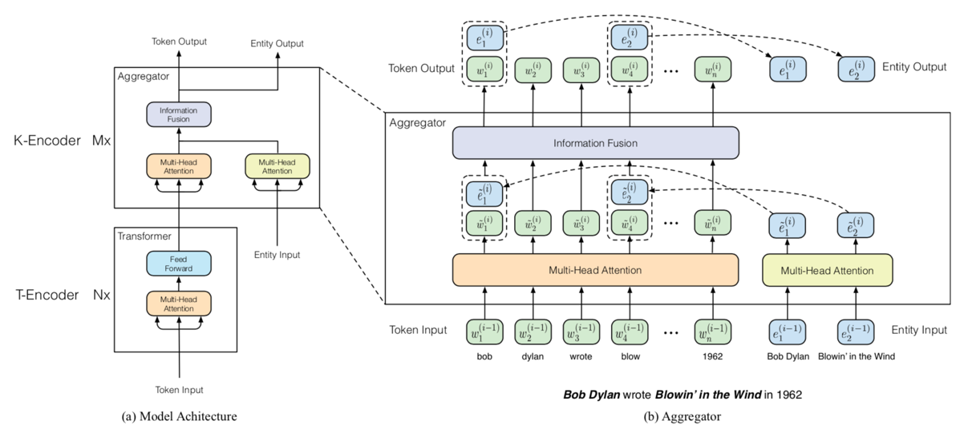
ERNIE: Enhanced Language Representation
with Informative Entities 清华

Slide 21
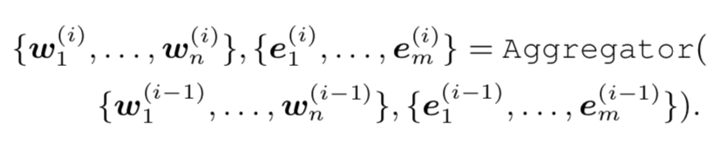
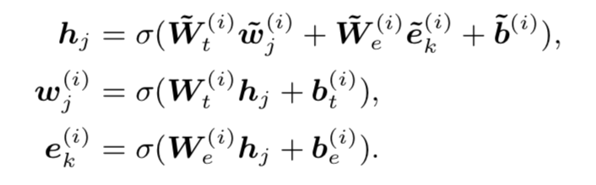
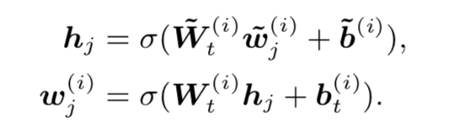
ERNIE: Enhanced Language Representation
with Informative Entities 清华
information fusion layer：
有对应实体的token：
无对应实体的token：

Slide 22
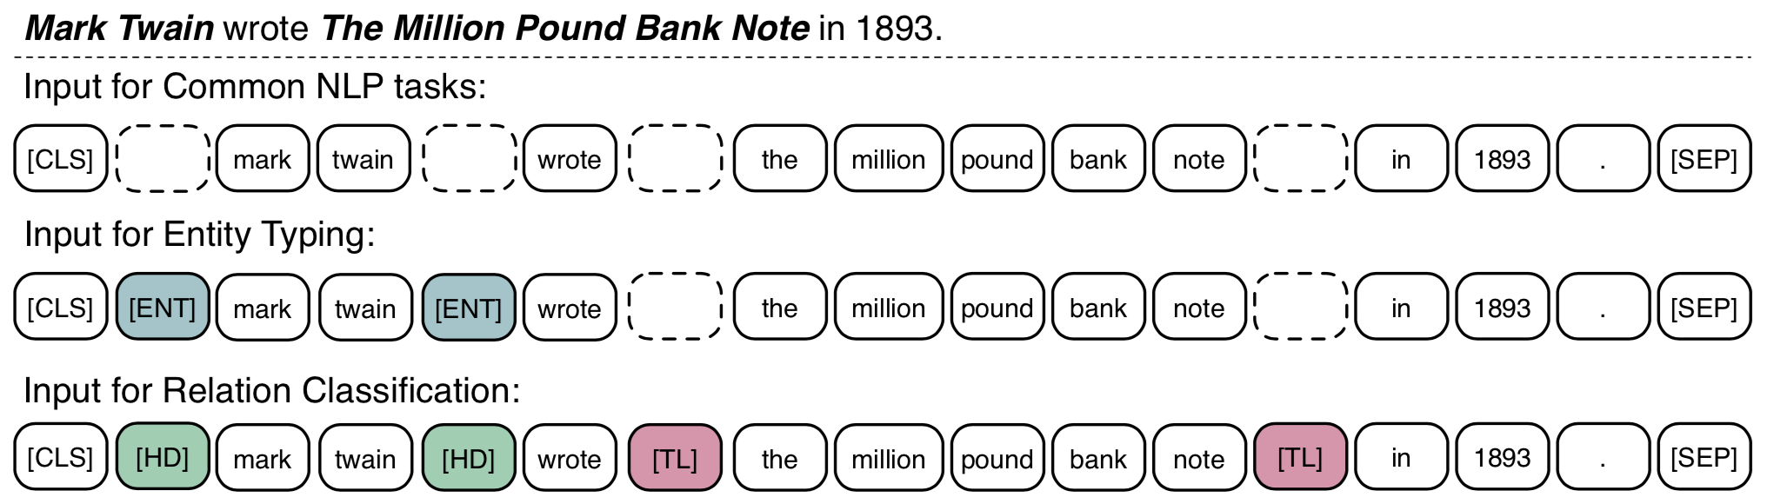
ERNIE: Enhanced Language Representation
with Informative Entities 清华
为特定下游任务设计的标记token：

Slide 23
ERNIE: Enhanced Representation through
Knowledge Integration 百度

Slide 24
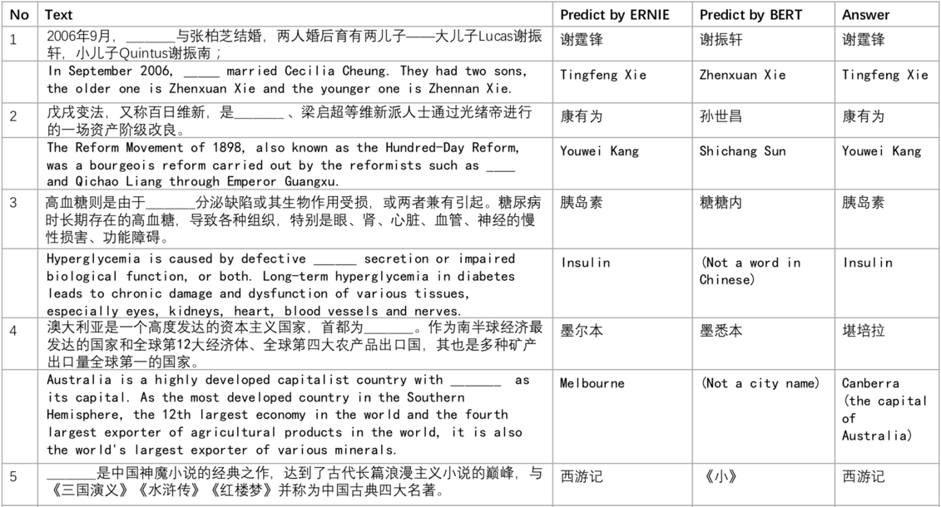
ERNIE: Enhanced Representation through
Knowledge Integration 百度

Slide 25
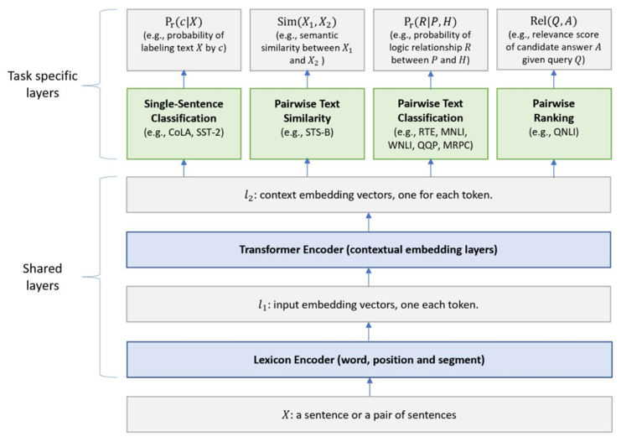
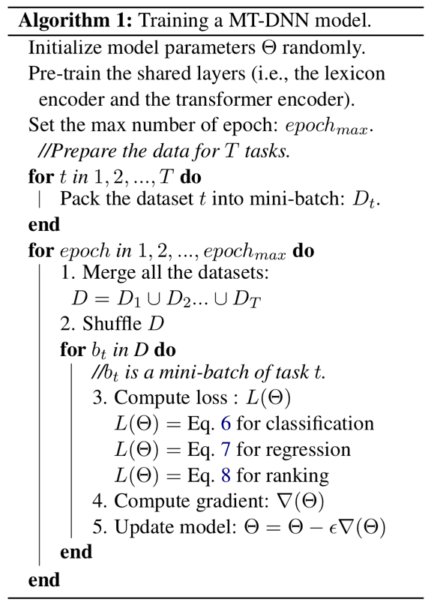
ERNIE 2.0: A Continual Pre-Training Framework
for Language Understanding 百度
MT-DNN：

Slide 26
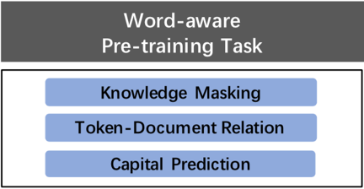
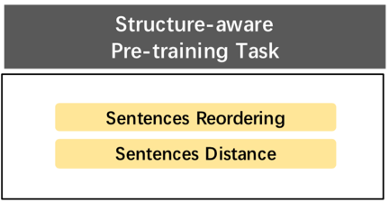
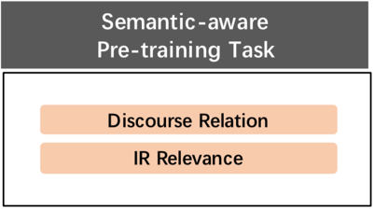
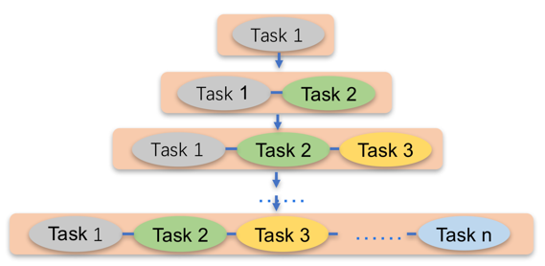
ERNIE 2.0: A Continual Pre-Training Framework
for Language Understanding 百度

Slide 27
参考文献：
Attention Is All You Need
BERT: Pre-training of Deep Bidirectional Transformers for Language Understanding
ERNIE: Enhanced Language Representation with Informative Entities
ERNIE: Enhanced Representation through Knowledge Integration
Multi-Task Deep Neural Networks for Natural Language Understanding
ERNIE 2.0: A Continual Pre-Training Framework for Language Understanding

Slide 28
谢谢！

